Slide 1
Open Source OS (Linux)
برمجة مفتوحة المصدر
Lecture 5
By Scholar PhD. Edris Hussain Mohammed |karary university
Department of Information systems
Edruis.hessan@gmail.com
2025

Slide 2

Lecture 5 Topics:
Basics of Processes
Parent & Child Processes
Process Types
Process Attributes
ps Command: Process Status
top command
Inter-Process Communication
Package Management Overview
Software Packages
Package File Name Format
dpkg Command
Problems with dpkg
Installing Packages using apt command
Un-Installing Packages using apt
Software Repository

Slide 3
Basics of Processes
A Process is an instance of a running program, and there can be
multiple instances of the same application Linux is a multi-tasking OS, can run multiple processes simultaneously and each process may have multiple threads, where a thread is just another process (of special nature)
Each user starting a process becomes its owner
The process owner does not have to be the same as the owner of the binary file for the process
Each process have an owner, some processes started by the system can be owned by the root user
The process owner has privileges on his process like (kill, pause, resume)
The ‘root’ user have super powers on all system processes
The process inherits its user privileges when trying to access resources(for example when a process tries to write in a file)

Slide 4
Parent & Child Processes
Each process that creates another becomes the parent, and the new process becomes the child process
systemd” process is started at system boot and it is the grand parent of all processes in the whole system
Process ID (PID) is a unique number to identify the process
Each process will maintain its PID and the PID of its parent
The systemd process has PID= 1 and PPID= 0
is a family of processes (A process, its children, grand-children, ...etc) and when a process is created it becomes a member of the process group of its parent
pstree is the command to showthe Process tree hierarchy
  $ pstree(Showtree starting at systemd process)
  $ pstree -p (to showPIDs of all processes)
  $ pstree 1025 (Showtree starting at processwith PID = 1025)

Slide 5
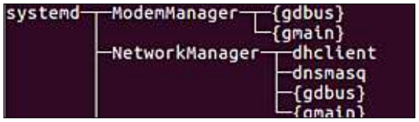
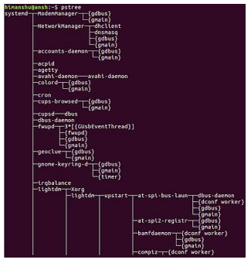

Slide 6
Process Types
Processes can be classified into one of the following,
Interactive Process: is started by a user within a terminal and It is attached to its terminal, and will be killed if its terminal is closed
Automatic Process(Batch Process) is not started directly by the user, instead, the user schedule it for a later start and it is not attached to terminal
Daemon Process: is a process that runs continuously in the
background to perform a task, or waiting for services to be
requested from it and they normally start at system startup)

Slide 7
The Job Control
Job is the execution of a command in a terminal and it can be a single process or multiple connected processes
Jobs can run in the below modes:
Foreground Job: All input and output of the terminal is exclusively for this job
To Start a job in the foreground just type the command like firefox
Background Job: the Input and output do not utilize the terminal, and multiple Jobs can be in the background for the same terminal
To start a job in the background use & sign at the end firefox &
To pause the foreground Job use Ctrl-z
To resume the paused Job in the foreground use fg
To Interrupt and stop a foreground Job use Ctrl-c

Slide 8
Process Arttribtes
• The process ID or PID: a unique identification number used to refer to the process.
• The parent process ID or PPID: the number of the process (PID) that started this process.
• Nice number: the degree of friendliness of this process toward other processes
• Terminal or TTY: terminal to which the process is connected.
• Real User ID (RUID): the user who started the process
• Effective User ID (EUID): the user whose privileges will be inherited by the process when accessing resources
Real Group ID (RGID): The primary group of the user who started the process
Effective Group ID (EGID): The Group ID whose privileges are inherited by the process when accessing system resources
NOTE: By default RUID and EUID has the same value also RGID and EGID.

Slide 9
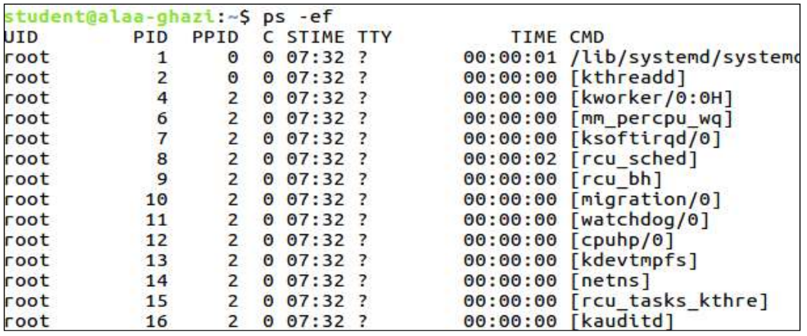
ps Command: Process Status
$ ps <options> | Examples
-e Everything, all processes -f Full format listing. -u username Display username’s processes. -p pid Display information for PID | ps -e Display all processes. ps -ef Display all processes, full. ps -eH Display a process tree. ps -e --forest Display a process tree. ps -u username Display user’s processes.

Slide 10
top command
top Command: Displays a dynamic view of the resource usage of system processes .
$ top
  While the “top” tool is running,
  Push ‘M’ to sort by memory usage
  Push ‘P’ to sort by CPU processing usage
  Push ‘T’ to sort by Time
  Push ‘k <pid>’ to kill process by its pid
  Push ‘h’ for getting a help page for all options
  Push ‘H’ to enable/disable showing threads separately

Slide 11
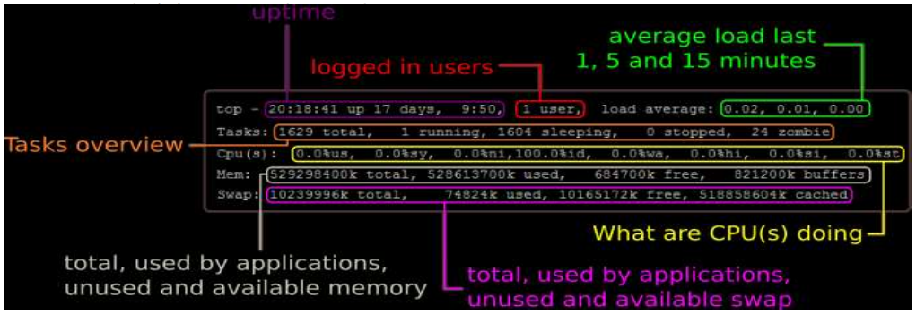

Slide 12
Inter-Process Communication
Inter-Process Communication IPC: Allow processes to exchange information.
IPC mechanisms:
7.1 Signals: one word exchanged between processes and Kernel uses them to notify processes when certain events in response to interrupts and exceptions
A process or thread can block a signal
Example of a command that uses signal is kill
kill command is a built-in command which sends a signal to a process to terminates the process.
kill sends TERM signal by default but it can be used to send ay other
signal, like in examples below: How to suspend firefox process, resume it and then terminate it using process PID.

Slide 13
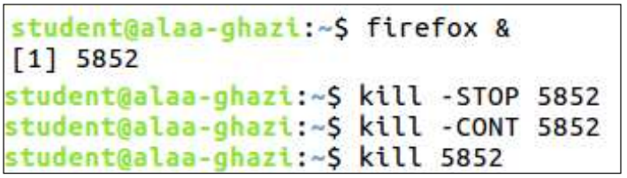

Slide 14
The end

